Slide 1
Honeypot for Café Wi-Fi: A Decoy-Based Cybersecurity Model
Presented by: Shaikh Muqtasida & Arya Gawit
Internship Program: DigiSuraksha Cybersecurity Internship

Slide 2
Introduction
Cybersecurity is critical in public spaces like cafés.
Open Wi-Fi is convenient, but it’s often not secure.
Attackers can intercept traffic or scan for open devices.
We explore honeypots as a way to detect and learn from such attacks.

Slide 3

Problem Statement
Café Wi-Fi networks are vulnerable due to weak/no encryption.
There’s little monitoring or awareness of suspicious activity.
This makes it easy for attackers to sniff traffic or scan for targets.
We need a way to observe such threats without putting real systems at risk.

Slide 4

What is a Honeypot?
A honeypot is a fake computer system or service. It is designed to attract attackers. The system logs the attacker's actions for research or defense. It acts as a trap: attackers think it's real, but it’s only for monitoring.

Slide 5
Types of Honeypots
Low-interaction honeypots: Simulate services (e.g., fake web server): Easier to build. Logs simple interactions. (Used in our project)
High-interaction honeypots: Simulate full systems (e.g., real OS): Harder to build. Captures advanced attacker behavior.
Our focus: Low-interaction honeypot using Python.

Slide 6
Why Café Wi-Fi Needs Honeypots
Public Wi-Fi is a frequent target for scanning, snooping, and phishing.
A honeypot can alert café admins to malicious activity.
It helps researchers study common attack patterns in a safe way.
It is ethical, legal, and doesn't risk real user data.

Slide 7
Our Research Objective
Create a simple honeypot that mimics a service on café Wi-Fi.
Log attempted connections from potential attackers.
Analyze logs to understand how attackers behave in public networks.
Raise awareness and propose solutions.

Slide 8
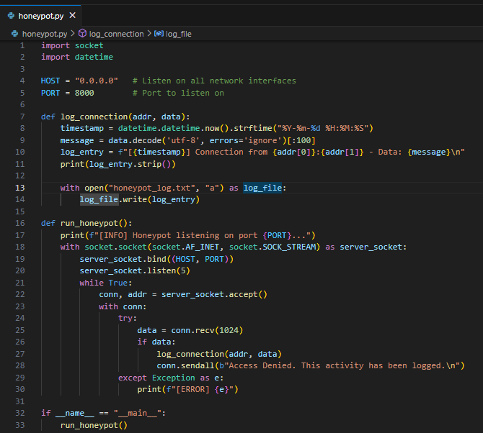
Sample Honeypot Tool
We built a honeypot using Python’s socket module. It listens on port 8000 for any connection attempt. Logs include IP address, time, and request data. It’s not a real server, just a fake one to attract scans.

Slide 9
Sample Output / Observation
Example log entry:
[2025-05-10 13:04:12] Connection from 127.0.0.1:52342 – Data: GET / HTTP/1.1...
What it tells us:
Someone tried to connect to our fake service
Could be a port scanner or curious user on the café Wi-Fi
Logs help us detect unusual behavior before real damage

Slide 10
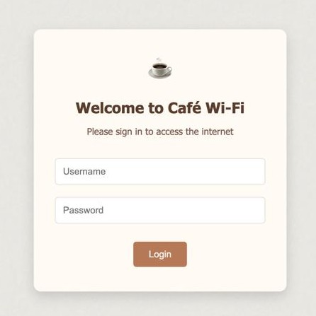
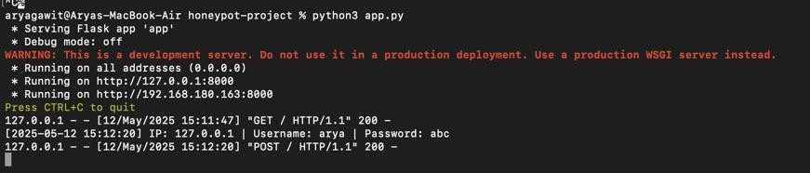
Sample Honeypot Tool
A fake login page is deployed using Python Flask on port 8000.
The page mimics a public café Wi-Fi login screen, asking for a username and password.
When a user submits credentials, a fake “Access Denied” message is shown on the screen.
The attempted username, password, IP address, and timestamp are logged in the terminal for analysis.
This simulates an attacker or unauthorized user attempting to access network services.
The system does not authenticate any user — it only captures behavioral data for passive monitoring.

Slide 11
Market Relevance & Ethics
Honeypots are used by companies, universities, and governments.
Legal and ethical if used for detection (not attacking back).
Can be deployed in small cafés or startups with limited security.
Helps educate owners about basic cyber threats.

Slide 12
Future Scope
Add real-time notifications for suspicious behavior
Visual dashboard for monitoring
Install honeypot on a Raspberry Pi and keep it running in a café
Use AI to auto-analyze attack patterns

Slide 13
Thank you
GitHub link with research paper available on request:
Click here to access GitHub link
Tool Demo Video Link:
Click here for Video

